Slide 1

CLIENT SERVER PROGRAMMING USING DUAL STACK (IPv4 and IPv6) HOST
Batch Details : Batch 16
Name USN
S Bharath 1NT18EC134
Shaik Abdul Aleem 1NT18EC143
Likith N 1NT18EC083
Rizwan Khan 1NT18EC130
Project Supervisor
Prof. Sitaram Yaji
Professor Dept. of Electronics and Communication Engineering
Nitte Meenakshi Institute of Technology Yelahanka, Bangalore-560064

Slide 2
Presentation Outline
Brief Introduction
Literature Survey
Research Gap Analysis/Drawbacks in Existing Systems
Project Objectives
References

Slide 3
Introduction
The internet can be accessible worldwide which is system of interconnected networks. Two current versions of the Internet Protocol (IPv4 and IPv6 ) are provided by Internet Assigned Numbers Authority (IANA).
IPv4 protocol was already allotted to Regional Internet Registries (RIR) and there is no more IPv4 address to allot and IANA has started issuing the IPv6 address to RIR. In February 2011, all IPv4 addresses had vanished and now we are going for IPv6.
Therefore several mechanisms are required which ensures smooth, stepwise an independent change to IPV6. Not only is the transition, integration of IPv6 is also required into the existing networks.
The solutions (or mechanisms) can be divided into three categories: dual stack, tunneling and translation.
Dual-stack is a preferred, most versatile way to deploy IPv6 in existing IPv4 environments.

Slide 4
Literature Survey
Implementation of IPv6 Over IPv4 Using Dual Stack Transition Mechanism (DSTM) on 6iNet
Moving from Internet Protocol version Four (IPv4) to Internet Protocol version six (IPv6) is not straightforward because IPv4 and IPv6 are incompatible protocols.
To enable the smooth integration between IPv4 and IPv6, several transition mechanisms have been proposed by IETF IPng Transition Working Group (NGTrans). One of them is Dual Stack Transition Mechanism (DSTM).
The DSTM architecture is consist of three (3) parts. They are the client (using FreeBSD and Linux as an operating system), the server and the DSTM gateway or called tunnel end-point router (TEP).

Slide 5
Implementation of IPv6/IPv4 Dual-Stack Transition Mechanism
With the rapid development of Internet, IPv4 protocol can no longer meet the needs of users. This is mainly due to the limitations of IPv4 in terms of addresses, routing and security.
Correspondingly, IPv6 has the advantage of large address space, security, mobility, quality of service and so on. So IPv6 protocol has become the inevitable trend of network development. However IPv4 and IPv6 are incompatible protocols, so a solution to transition is required.
In order to achieve smooth and stepwise transition, IETF recommends three kinds of transition mechanisms: dual stack, tunneling and translation technology.

Slide 6
IPv4 to IPv6 Migration and Performance Analysis using GNS3 and Wireshark
The IPv4 protocol is not particularly efficient in its use of the available space, with many addresses being wasted. The internet authorities started to predict address exhaustion in the late 1980s and IPv6 was developed in the 1990s as the long-term solution.
Dual-Stack Transition Technique :IPv4 and IPv6 do not have to be an ‘either or’ decision. In a dual stack implementation, a network interface can have both an IPv4 and IPv6 address at the same time. It can communicate using either of the protocol available.
Design and Configuration of the Dual-Stack Transition Technique Dual stack is designed to support both the IPv4 and IPv6 addresses on the same network interface, thereby allowing the data to transfer from IPv4 network to IPv6 network using both static and dynamic routing.
The network consists of five routers, two Ethernet switches, and four end hosts. All router interfaces, as well as the hosts, have been configured with an IPv4 address as well as with an IPv6 address. The network can then communicate using either protocol.

Slide 7
Research Gap Analysis/Drawbacks in Existing Systems
Transition to IPv6 is in progress in LANs and WAN.
A dual stack host may need to communicate with IPv4 only host and IPv6 only host. This is an implementation project for this scenario

Slide 8
Project Objectives
The following are the proposed objectives of the project based on the research gaps:
To Implement client server programming on dual stack host
Dual stack host running two server programs Ipv4 client (VoIP, udp) Ipv6 client (data application/TCP)
Both clients contacting dual stack host at the same time
Desktop/Laptop and Raspberry Pi boards will be used for establishing Communication

Slide 9
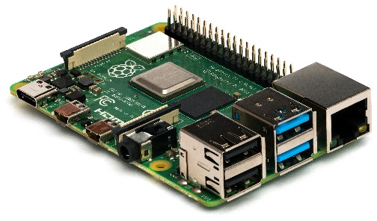

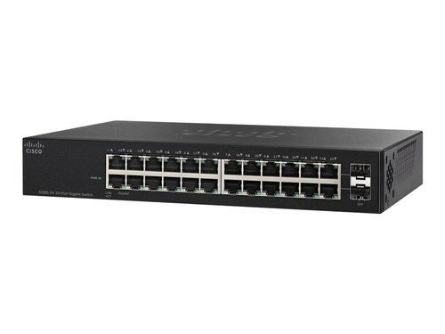
Three Hosts on LAN
Raspberry Pi
(IPv6 only)
Switch
Dual Stack Host (IPv4 and IPv6)
Linux System
(IPv4 only)
Note : Works for WAN also

Slide 10
References
R. K. CV and H. Goyal, "IPv4 to IPv6 Migration and Performance Analysis using GNS3 and Wireshark," 2019 International Conference on Vision Towards Emerging Trends in Communication and Networking (ViTECoN), 2019, pp. 1-6, doi: 10.1109/ViTECoN.2019.8899746
J. Hyun, J. Li, H. Kim, J. Yoo and J. W. Hong, "IPv4 and IPv6 performance comparison in IPv6 LTE network," 2015 17th Asia-Pacific Network Operations and Management Symposium (APNOMS), 2015, pp. 145-150, doi: 10.1109/APNOMS.2015.7275417.
S. Aravind and G. Padmavathi, "Migration to Ipv6 from IPV4 by dual stack and tunneling techniques," 2015 International Conference on Smart Technologies and Management for Computing, Communication, Controls, Energy and Materials (ICSTM), 2015, pp. 107-111, doi: 10.1109/ICSTM.2015.7225398.
Hatim Mohamad tahir,Azman Taa,Norshakinah Bt. Md. Nasir, “Implementation of IPv6 Over IPv4 Using Dual Stack Transition Mechanism (DSTM) on 6iNet” Universiti Utara Malaysia, December 2014
Niranjan Ravi, Muppidathi Saravanan A, Manoranjan Periyasamy, Niraj Prasad Bhatta “Implementation of IPv6/IPv4 Dual-Stack Transition Mechanism”, Jain University, November 2014

